Slide 1

BUSI 265 Global Marketing Strategy
Dr. Cecilia Ruvalcaba

Slide 2

Culture and International Business

Slide 3
Culture’s Influence on Information Processing
High Context
http://www.mcdonalds.com.cn/
Low Context
http://www.mcdonalds.com/us/en/home.html

Slide 4
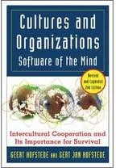
Hofstede’s Cultural Dimensions
A dimension is an aspect of a culture that can be measured relative to other cultures.
Power Distance
Collectivism versus Individualism
Femininity versus Masculinity
Uncertainty Avoidance
Long Term Orientation
Indulgence versus Restraint

Slide 5
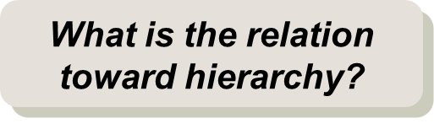
Power Distance
How individuals deal with inequalities.
High Power Distance:
Superiors and subordinates are unequal
Status and position is respected.
Titles are important.
Low Power Distance:
Individuals are equal.
Work roles can be flexible, less rules and protocols.

Slide 6
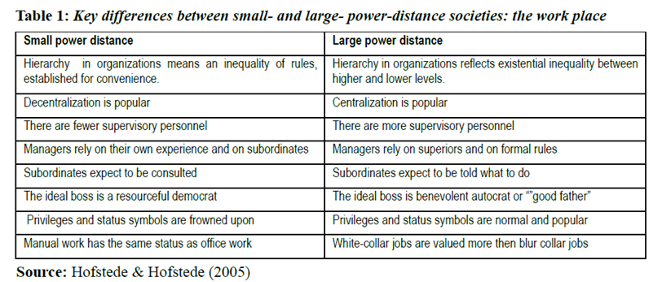

Slide 7
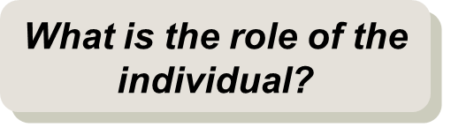
Collectivism vs. Individualism
In collectivist societies, interest of the group prevails over interest of the individual.
Collectivist:
Group harmony and cooperation is important.
Identity tied to group affiliation
Group decisions (consensus among family, team)
Individualist:
Independent action is a strong competency
Identity tied to individual traits
Individual decisions

Slide 8
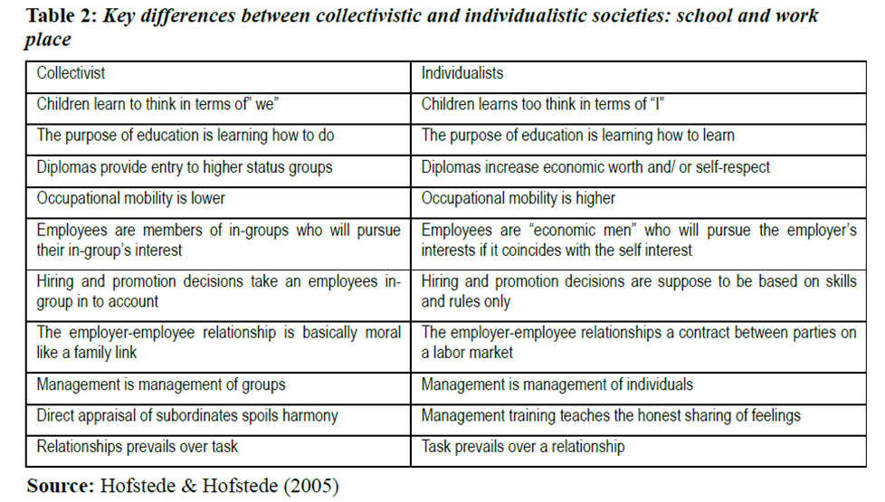

Slide 9

Femininity vs. Masculinity
Masculine Society:
Emotional gender roles are clearly distinct: men are supposed to be assertive, tough, and focused on material success whereas women are supposed to be more modest, tender, and concerned with the quality of life.
Feminine Society:
Emotional gender roles overlap: both men and women are supposed to be modest, tender, and concerned with the quality of life.
Assertiveness vs. Modesty
Structure vs. Consideration
Conflict: Win vs. Compromise
Rewards: Performance vs. Equality
Live to Work vs. Work to Live

Slide 10
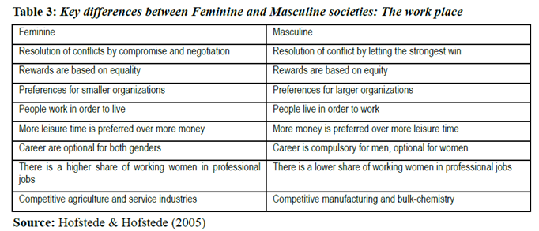

Slide 11
Uncertainty Avoidance
The extent to which members of a culture feel threatened by ambiguous or unknown situations.
Strong
Spend time on research before making change
Establish proper processes and systems
Weak
Demonstrate quick results
Flexibility and speed valued more than thoroughness

Slide 12
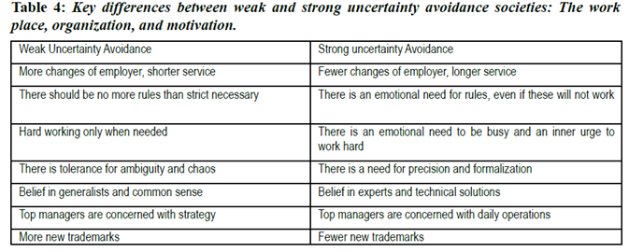
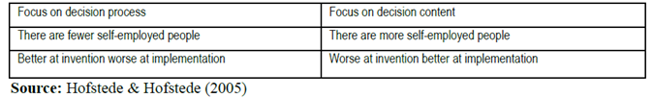

Slide 13

Long Term Orientation
The fostering of virtues oriented toward future rewards.
Long-Term
Big picture, long-term results
Thoroughness, discussion of possible outcomes are key
Goals and reports focus on one-year and long-term plans
Short-Term
Demonstrate immediate results
Efficiency, speed important in decision-making process
Goals and reports focus on one-month and quarterly plans

Slide 14
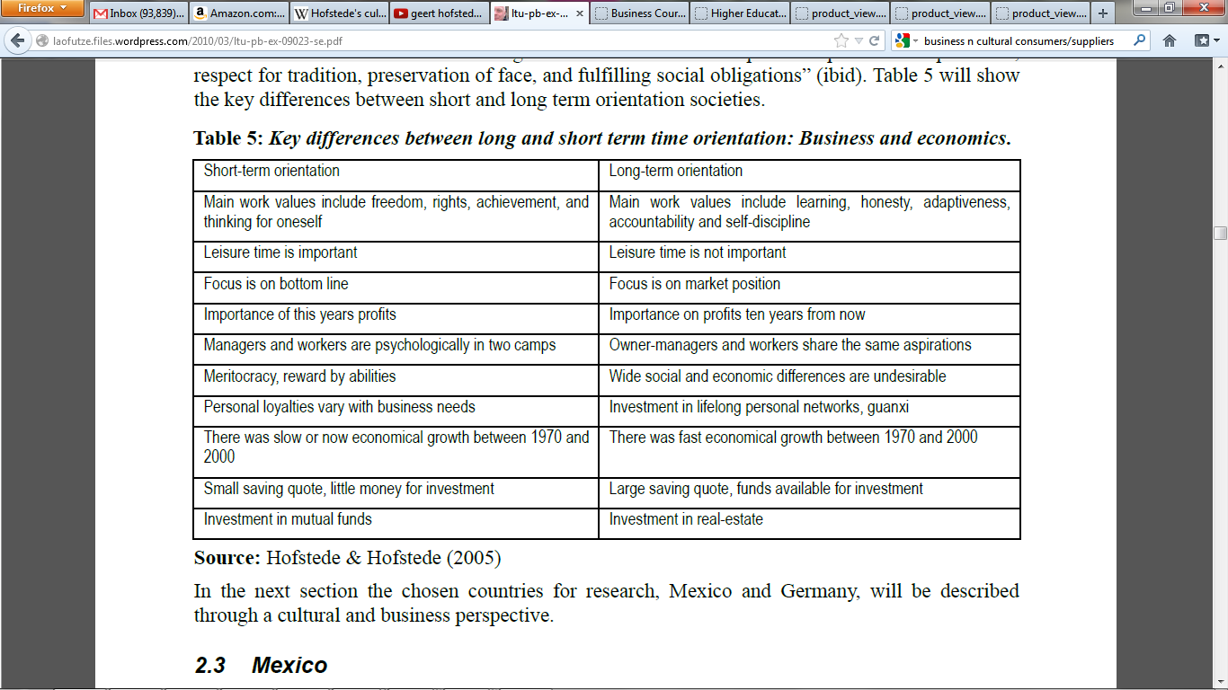

Slide 15
Indulgence vs. Restraint :(:
Indulgence
Tendency to allow relatively free gratification of basic and natural human desires related to enjoying life and having fun.
Restraint
Reflects a conviction that such gratification needs to be curbed and regulated by strict social norms.

Slide 16
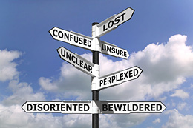
Why is this important?
Know the profile of you and your colleagues in order to leverage similarities and bridge gaps.
Learning Intercultural Communication
Awareness
Knowledge
Skills

Slide 17
SRC: American Culture on Management Style
Self Reference Criteria: Unconscious reference to one’s own cultural values
“Master of Destiny” viewpoint
Independent enterprise as the instrument of social action
Personnel selection and reward based on merit
Decisions based on objective analysis
Wide sharing in decision making
Never-ending quest for improvement
Competition yielding efficiency

Slide 18
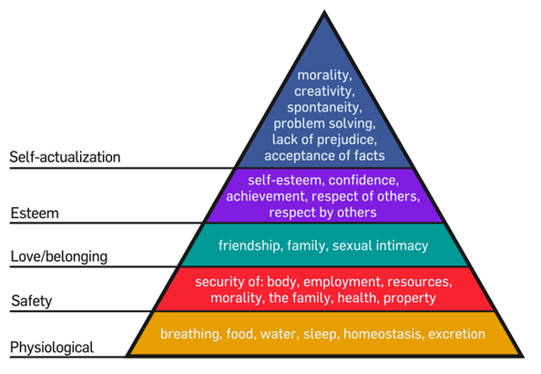
Motivating by Meeting Needs

Slide 19
Key Points of Maslow
How needs are satisfied.
Lower order needs: externally.
Higher order needs: internally.
How they motivate.
Deficiency: if not met, won’t become healthy person.
Growth: if met, person reaches full potential.
When each need becomes satisfied, we move up the hierarchy and the next need becomes dominant.

Slide 20
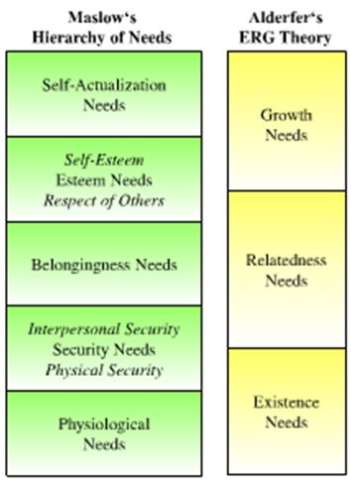
An Adjustment of Maslow’s Hierarchy- Alderfer’s ERG Theory
Three groups of core needs:
Existence needs
Desires for physiological and material well-being.
Relatedness needs
Desires for satisfying interpersonal relationships.
Growth needs
Desires for continued personal growth and development.
Research results on theory mixed.

Slide 21

Cultural Analysis
Cultural Practices
Cultural Symbols
Cultural Values
Cultural Codes
Media Culture
Common Themes and Differences
Cultural Dimensions:
Power Distance
Individualism vs. Collectivism
Uncertainty Avoidance
Masculinity vs. Femininity

Slide 22
Cultural Analysis cont.
Negotiating
Communicating about business and nonbusiness topics
Building working relationships
Resolving Conflicts
Defining work procedures and ethical behavior
Making decisions
Greeting one another
Establishing deadlines and meeting times
Dress
Entertaining and dining
Delivering presentations
Evaluating business ideas and proposals
Setting business priorities
Relating to authority figures
Selling and marketing to customers

Slide 23

Take Away for Today
Geert says what?
Geert, Maslow, Alderfer, Everett, etc… All tools to help us better understand our customer.
Culture & Strategy
Tools are guides to finding the right strategy.

Slide 24
Next Class
Chapter 5: Ethics, Sustainability and Corporate Social Responsibility
Due Wednesday 2/10:
Case: LV in Japan
IMP: Product & Country Descriptions
Wednesday February 24. Library
Database Session w/ Jack Schroeder
(Bring Computers)

